Slide 1
Neuro-rehab Special Interest Group 13 October 2018
Art therapy with brain-injured patients in hospital settings

Slide 2
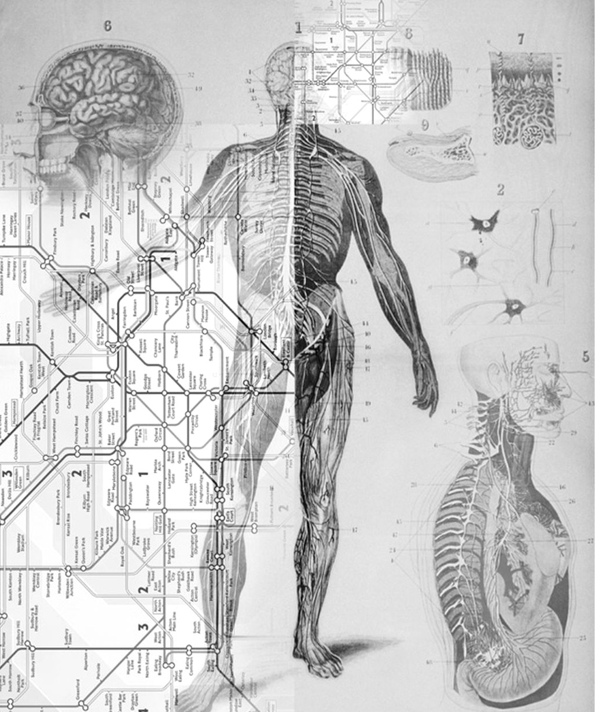
Introduction
Cressida Brotherstone, qualified 2017
Poppy Stevens, qualified 2016
David Little, qualified 2015
Newly qualified
Innovative use of art therapy in hospital settings
Neuro-oncology
Neuro-rehabilitation
Work in progress / case studies illustrate benefits and challenges of AT / thinking & isolation / sharing ideas & practice

Slide 3
Focus on multidisciplinary team and family constellation
How does art therapy fit into the jigsaw of patient care?
Sensory rather than cognitive
Managing uncertainty
Getting ‘unstuck’
Processing shame, guilt and loss
Working with feelings complements physical care ➔better recovery
Privacy & encouragement of independent choice
Thinking about life before brain injury
Supporting others’ need to help ➔ sense of hope

Slide 4
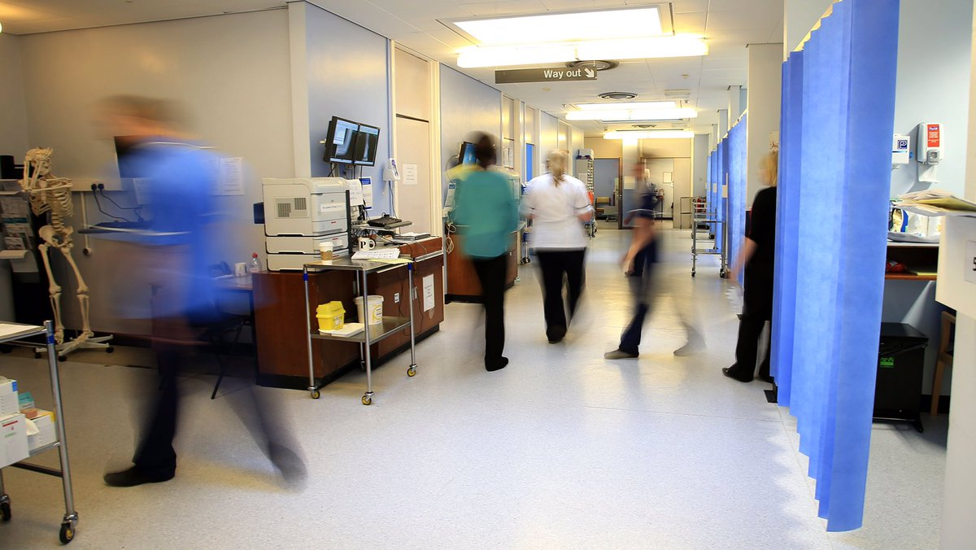
Focus on challenges in hospital settings
Part-time working (where intensive intervention may be more effective with patients with ABI)
Distractions and interruptions
Art Therapist may be processing envy, aggression, rejection, somatic responses
Perception of ‘progress’ – by patient and others – not being goal-driven
Practical v psychological support for patients
Evaluation and growing the evidence base

Slide 5
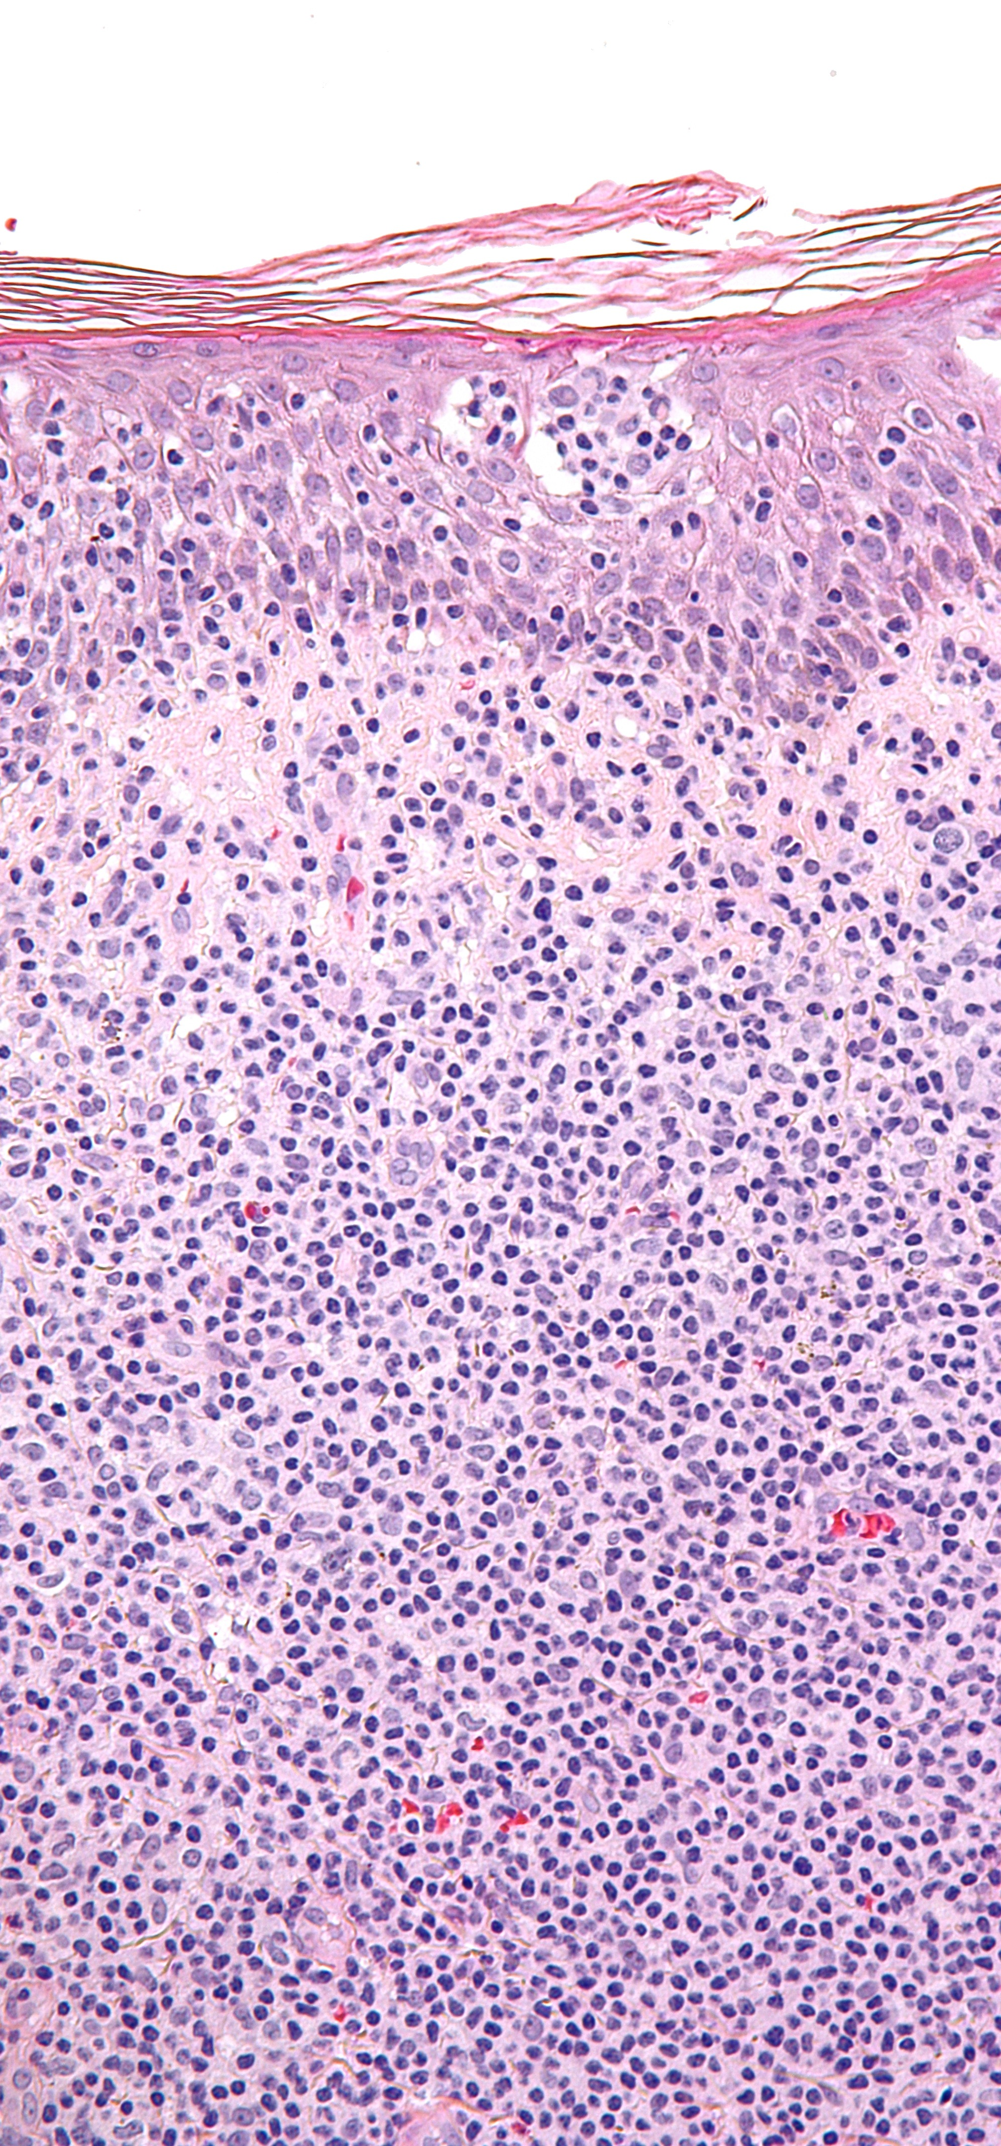
Case study 1
Male cancer patient in his 20s
Long-stay inpatient
Loss of speech and language
Art therapy referral for low mood

Slide 6
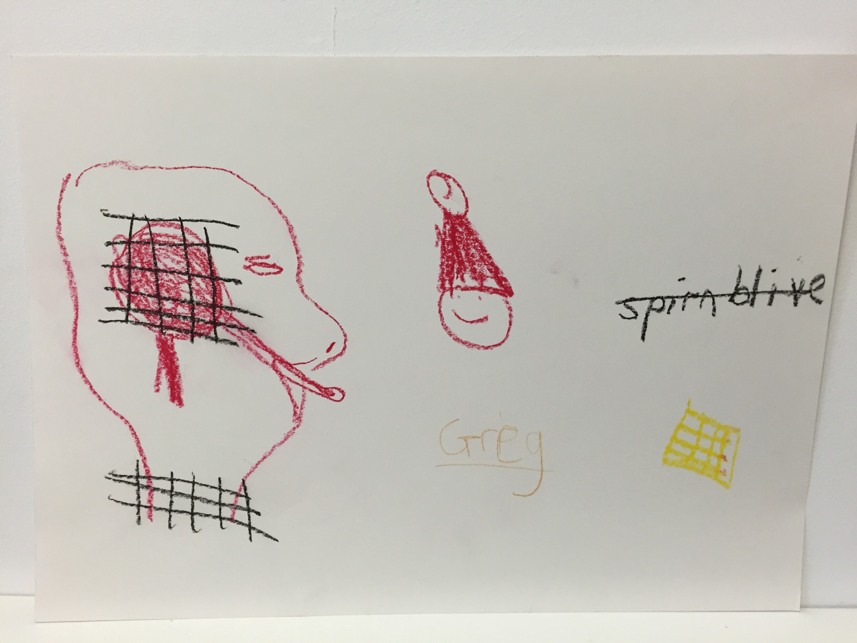

Slide 7
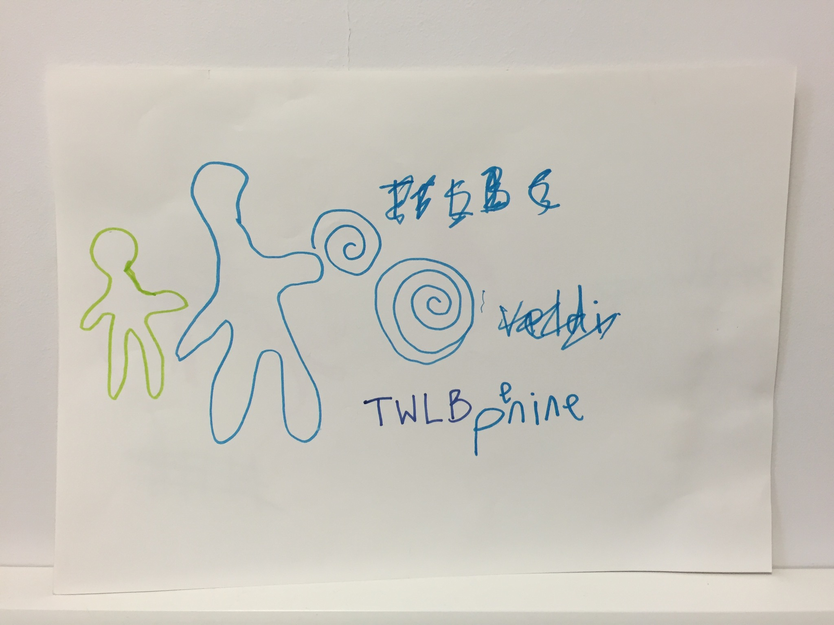

Slide 8
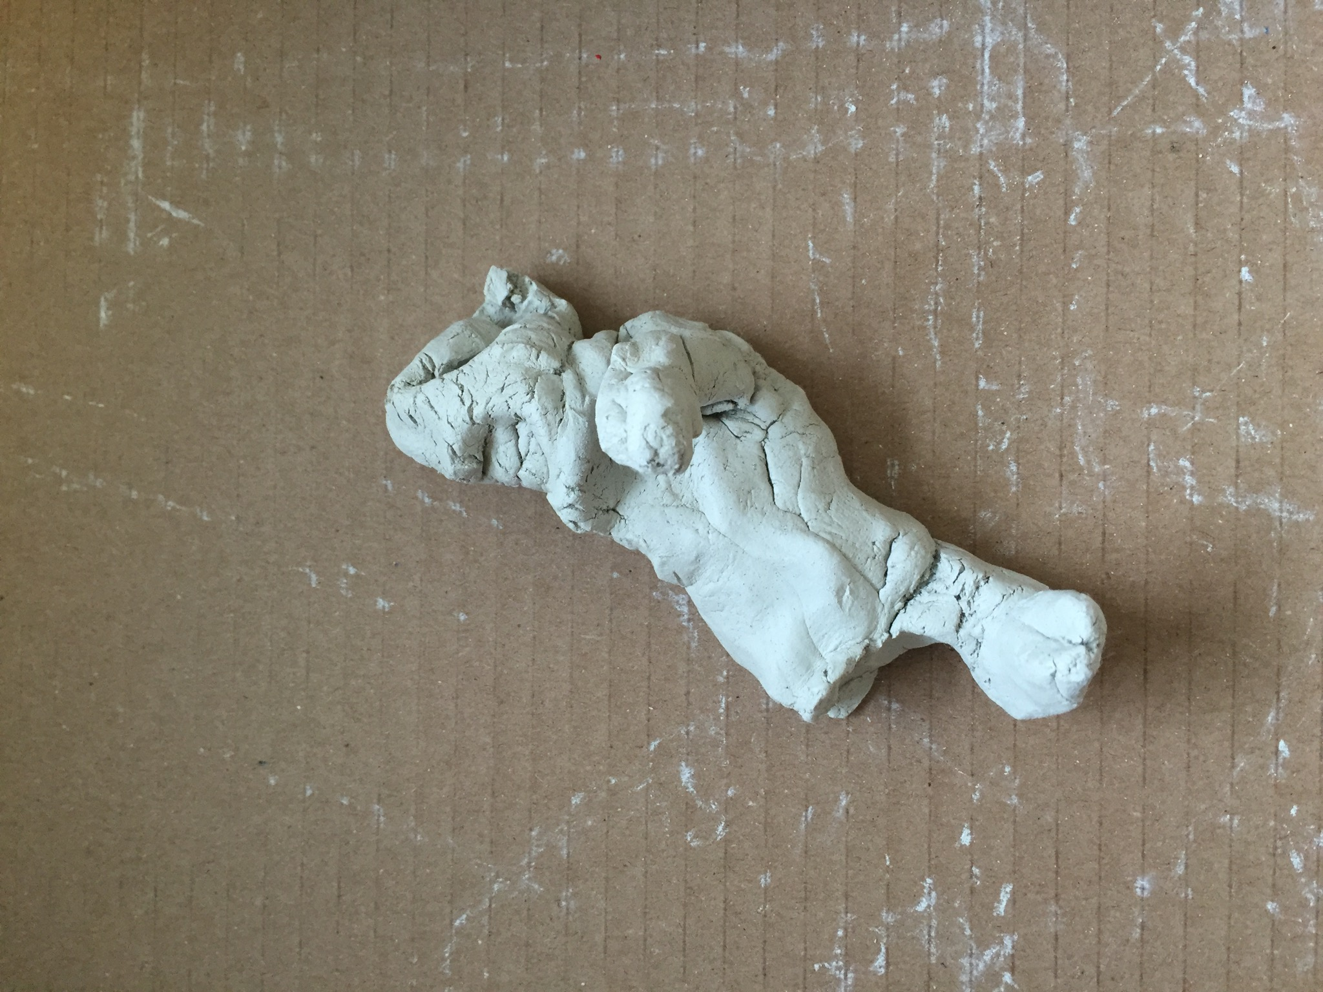

Slide 9
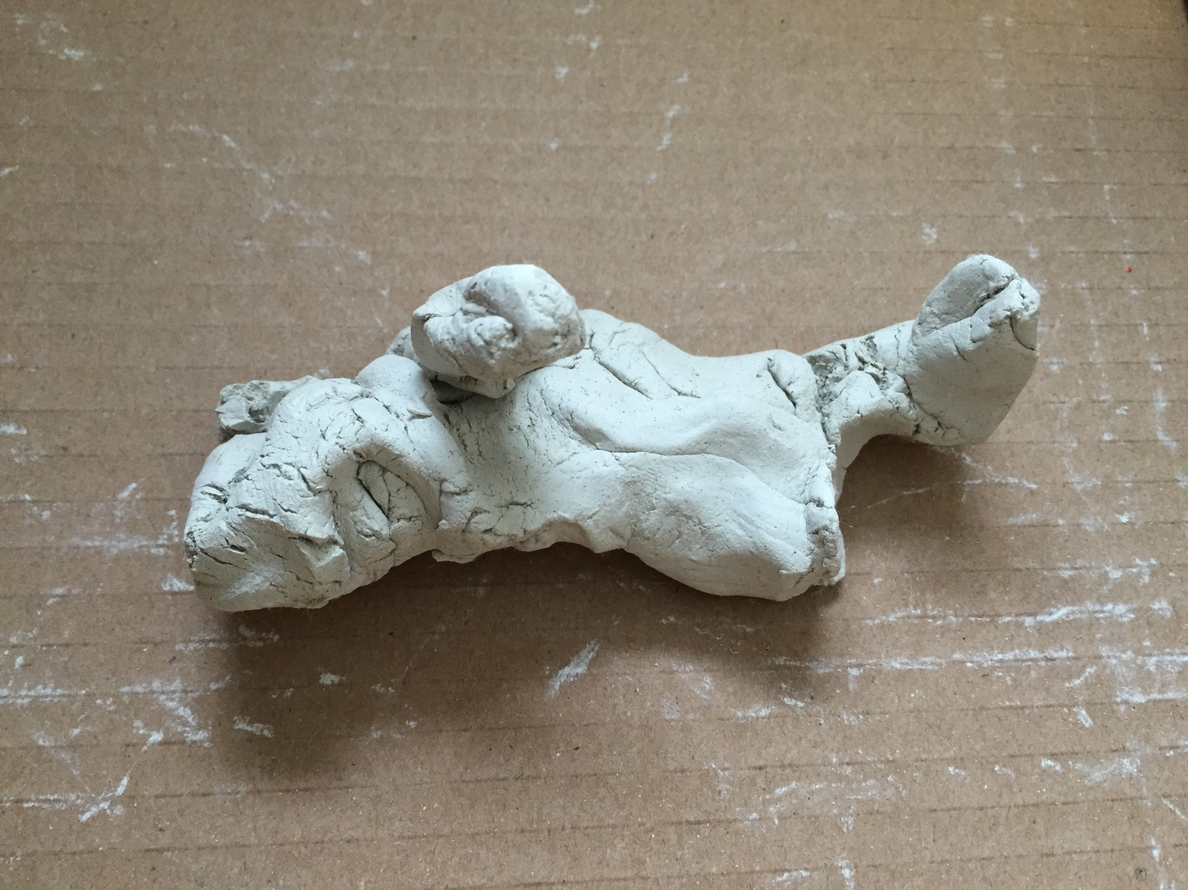

Slide 10
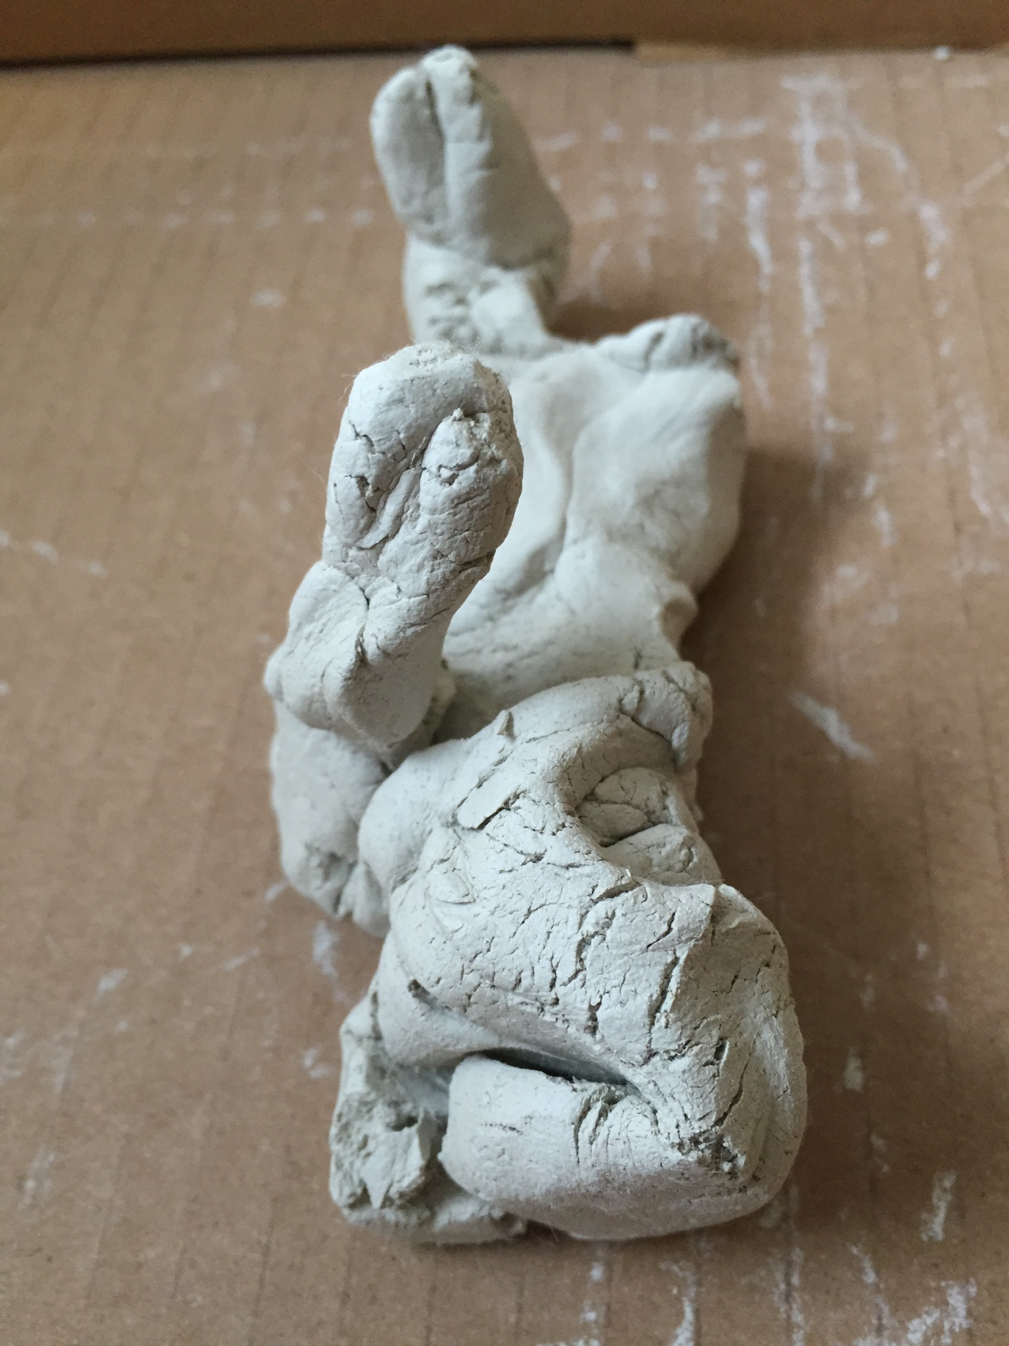

Slide 11
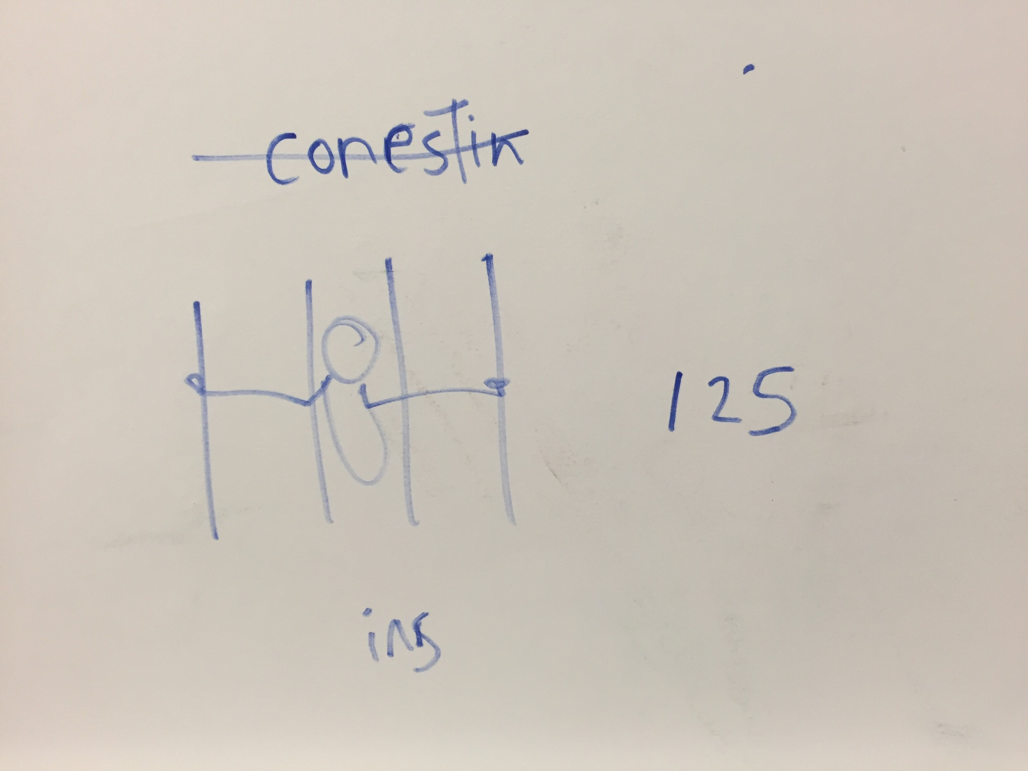

Slide 12
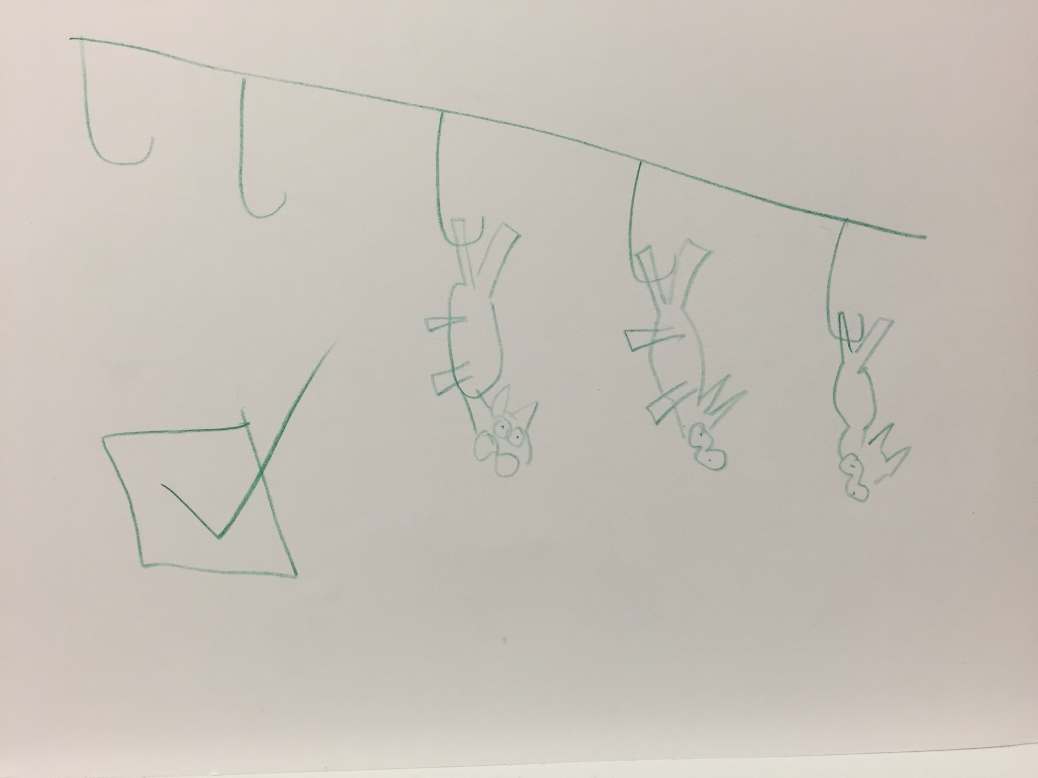

Slide 13
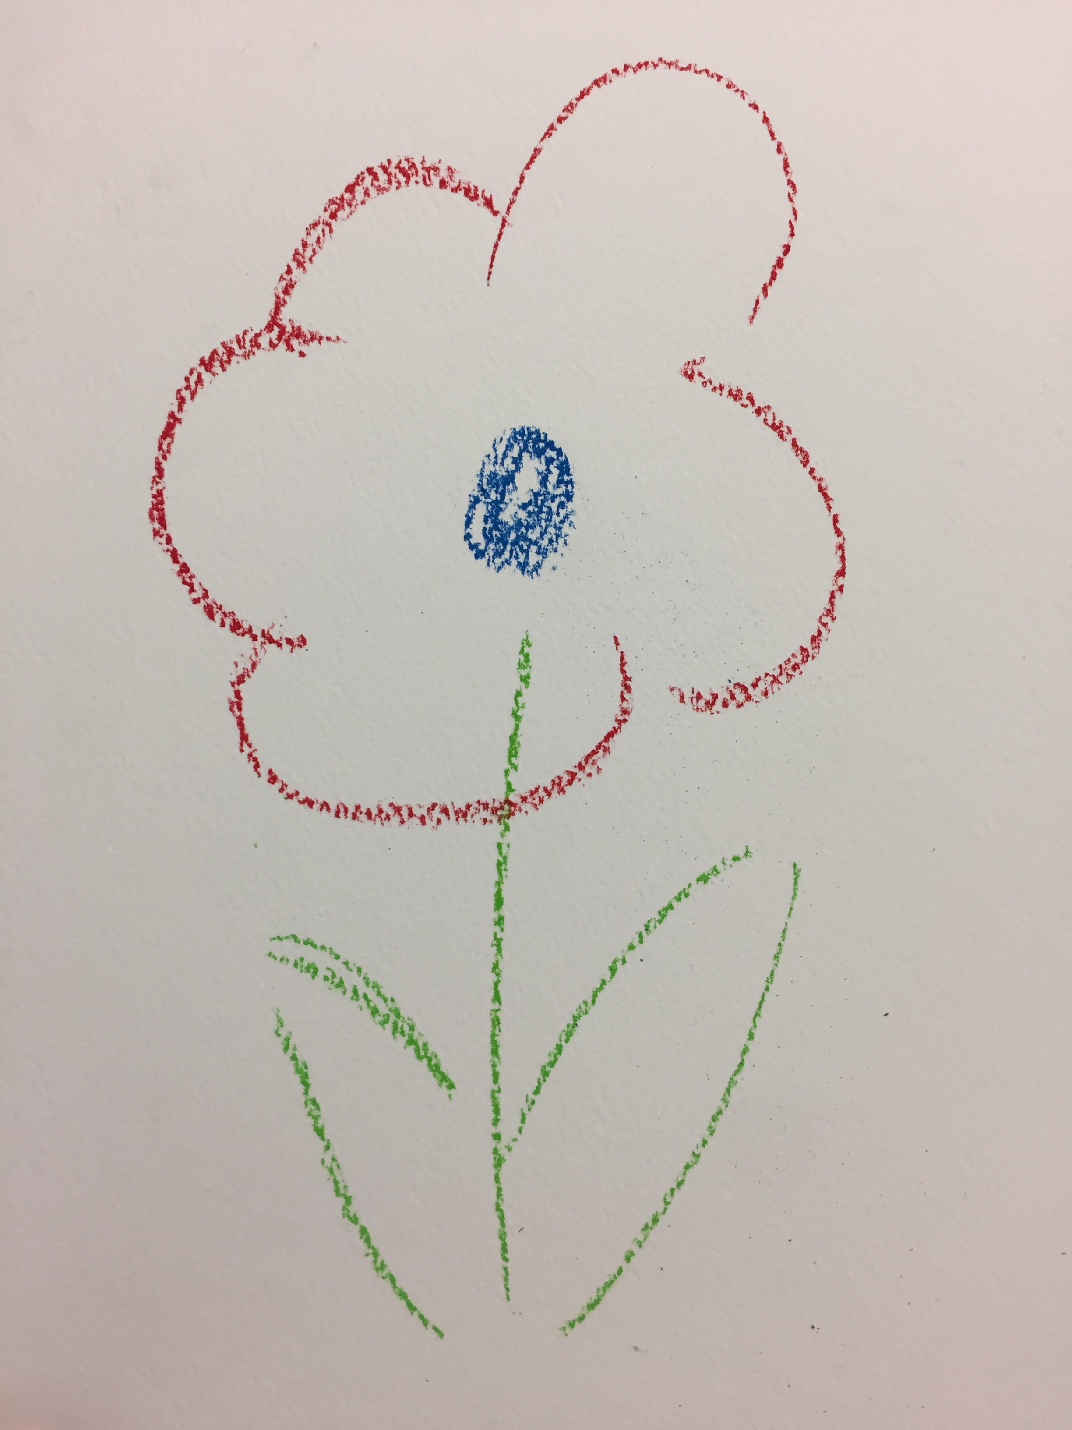
(my re-creation)

Slide 14
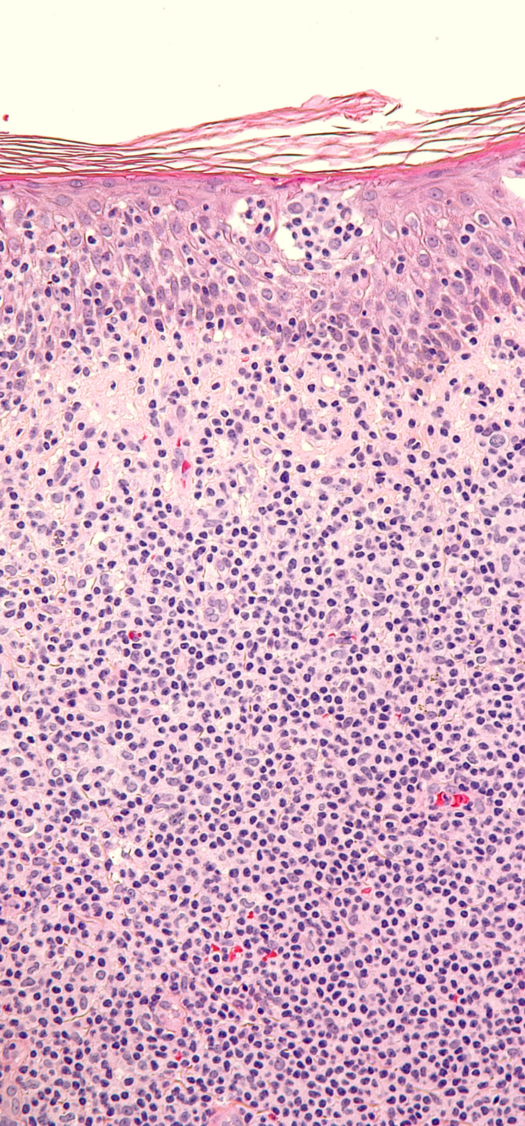
Project 2017-18
To develop and optimize art psychotherapy involvement with neuro-oncology patients and the neuro-oncology MDT.
To gather feedback from clinicians about the helpfulness of art psychotherapy as part of the neuro-oncology rehabilitation service.
Neuro-oncology patients typically suffer psychological distress
Pre- and post-diagnosis
Pre- and post-surgery
Following discharge from intensive radiotherapy
Due to cognitive impairment resulting in speech, limb and other deficits
Due to feelings of isolation
Benefits of the art psychotherapy intervention were described as:
Improved engagement with other therapies, e.g., physiotherapy
Increased ability to communicate effectively
Improved gross and fine motor function
Increased sense of personal agency

Slide 15
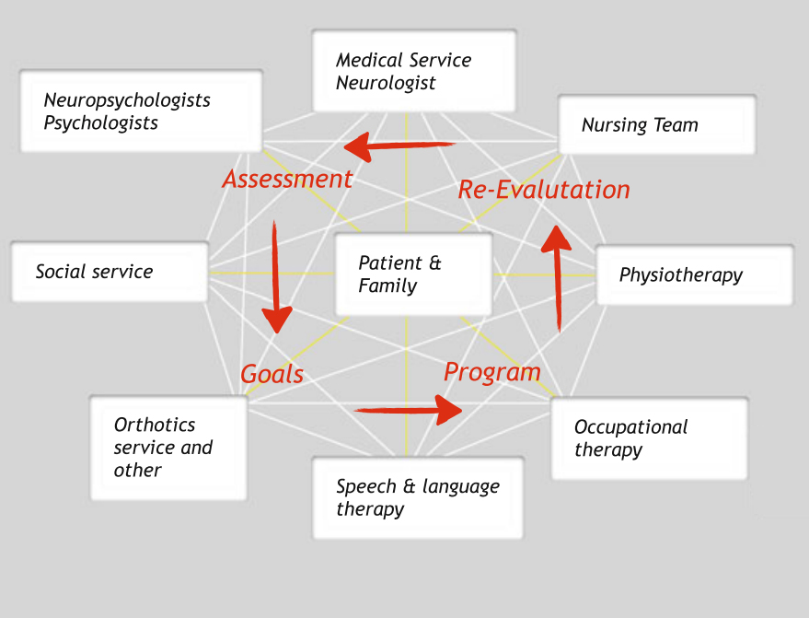
Specialist Neuro-Rehab inpatient service MDT
Neuro-oncology consultant
Clinical Nurse Specialist
Occupational Therapist
Physiotherapist
Speech &Language Therapist
Clinical Psychologist
Art Psychotherapist
Radiographer
Nutritionist
Neurosurgeon
Neurologist
Epilepsy specialist
This graphic from article about stroke rehabilitation – no art psychotherapy

Slide 16
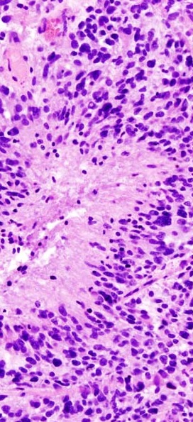
Case study 2
Male cancer patient in his 30s
Long-stay inpatient
Presenting symptoms:
Slurred speech, ataxic gait, difficulty looking to the right
Reduced power and sensory loss in right arm and leg
Diagnosis
Glioblastoma
Treatment
Ventriculostomy (pressure reduction)
Radical radiotherapy with concurrent and adjuvant Temozolmide (chemotherapy)
Intensive neuro-rehabilitation
Prognosis 12-18 months

Slide 17
Case study 2: referral to art psychotherapy
Presenting issues
Significant physical and cognitive impairments (hemi-sensory and motor impairments)
Withdrawn from conversations
Distressed and emotional when discussing treatment
Was fit and active; finding it difficult to come to terms with impairment
Daily low mood and anxiety
Initial aim of therapy
Promote positive engagement with neuro-rehabilitation

Slide 18
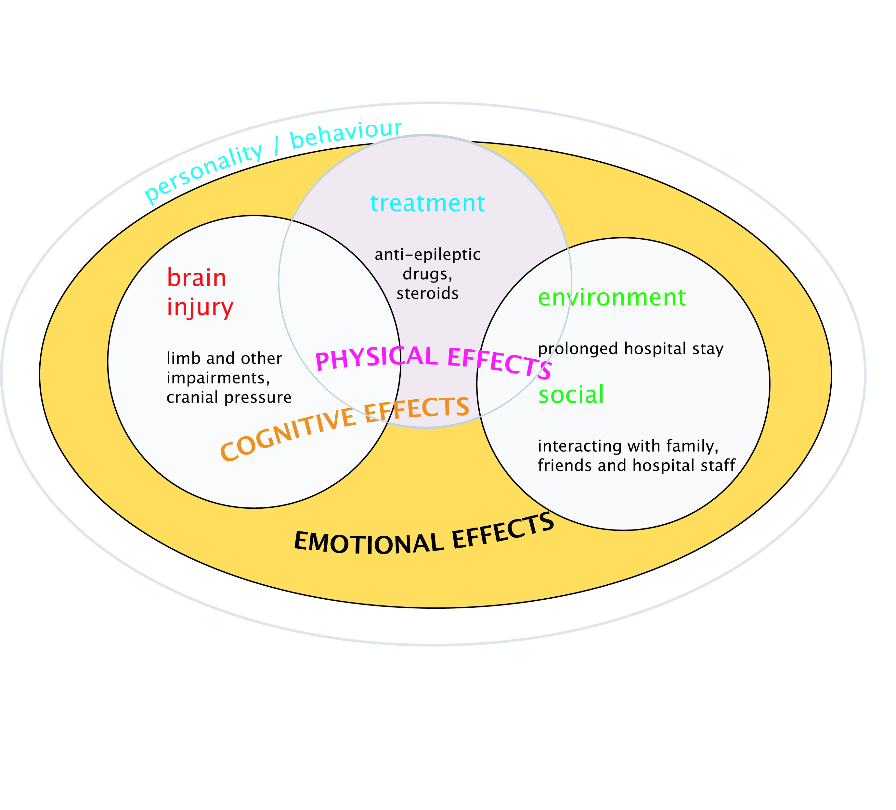
Shock and trauma of a life-limiting diagnosis…Freeze response, loss of motivation
Particular issues for young men – emasculation – access to support network

Slide 19
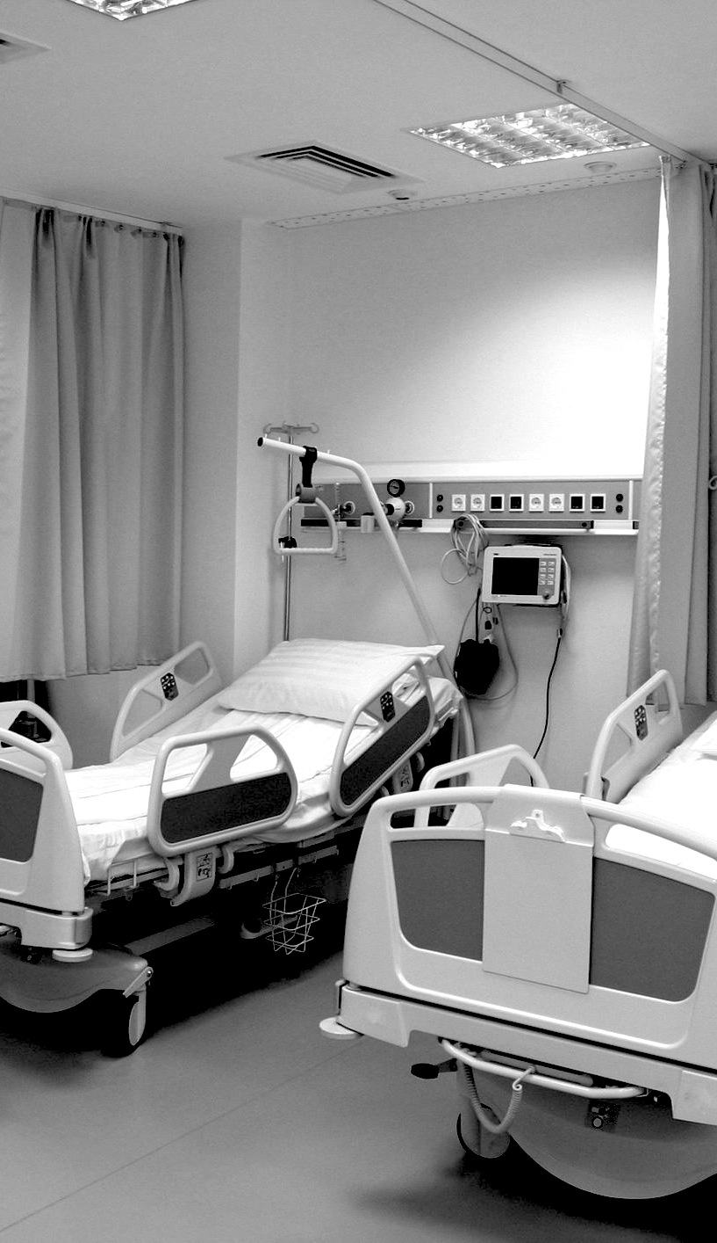
Case study 2: assessment (week 1)
Presence of family members
Physical presentation: physical (hand, leg, eye) / speech/ slow thinking speed / dysphasia /
Patient’s account: feeling overwhelmed; regaining functionality
My observations: grim determination
“Want to get back to where I was”
Offer and use of art materials
Art making
Reflection / Joint attention
Significance of hand shake

Slide 20
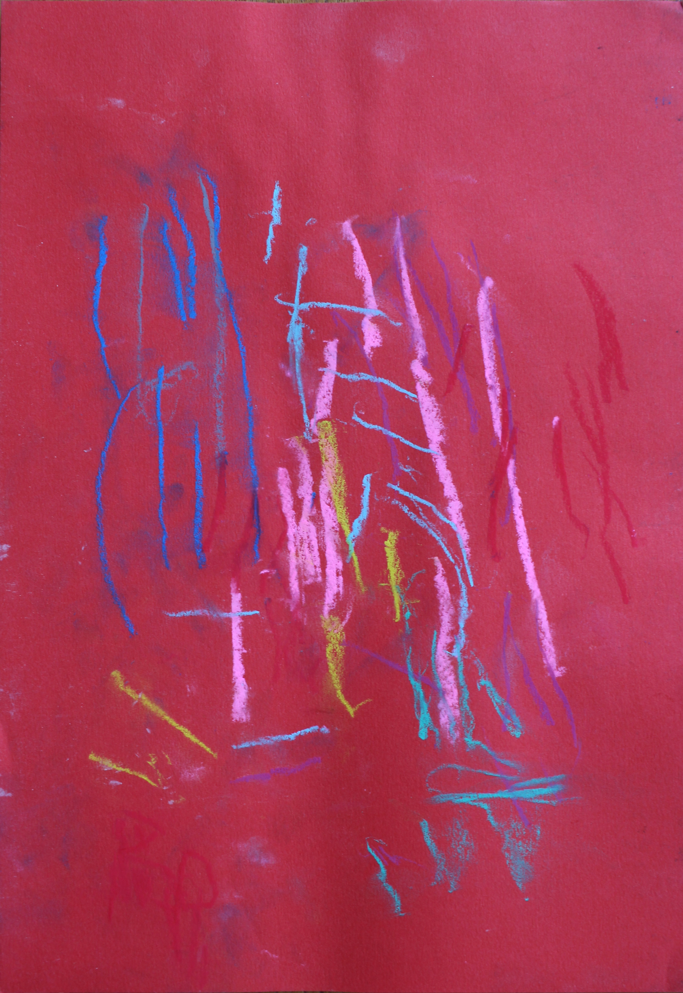
“cathartic”
“exploratory”
“hopeful”

Slide 21
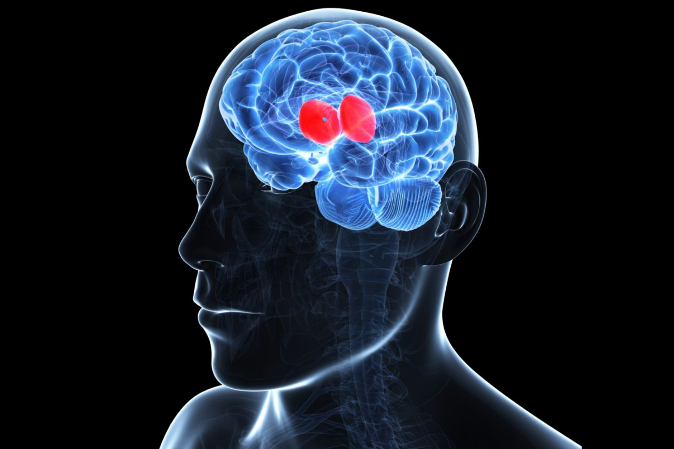
The thalamus is involved in several functions of the body including:
Motor control
Receives auditory, somatosensory, and visual sensory signals
Relays sensory signals to the cerebral cortex
Memory formation and emotional expression and integration
Pain perception
Controls sleep and awake states
Thalamus damage associated with
sensory and cognitive impairments:
Executive functioning
Emotion
Motivation
Forward planning
Perception
Attention
Memory
Depression
Linking psych symptoms to damage in specific brain regions difficult
Hard to know what patient perceives and whether patient has insight
Difficulty in assessing behaviours

Slide 22
Prior research suggests that trauma interrupts the normal functioning of the thalamus, causing it to shut down or slow due to sensory overload (van der Kolk, 2014 van der Kolk, B. A. (2014). The body keeps the score: Brain, mind, and body in the healing of trauma. New York: Viking. [Google Scholar]). In other words, the brain is not able to integrate traumatic experiences, and the danger remains unprocessed and ongoing. Individuals often cope with this sensory overload via dissociation or numbing behaviours. Trauma survivors may also appear rigidly stuck in the past because the thalamus (responsible for sensory integration) and the Dorsolateral Prefrontal Cortex (the ‘timekeeper’) have gone off-line (van der Kolk, 2014van der Kolk, B. A. (2014). The body keeps the score: Brain, mind, and body in the healing of trauma. New York: Viking. [Google Scholar]). An essential part of the healing process is the reintegration of these various neurological systems since ‘consciousness arises from a continuous “dialogue” between the thalamus and the cortex’ (Carr, 2008 Carr, R. (2008). Sensory processes and responses. In N. Hass-Cohen, &R. Carr (Eds.), Art therapy and clinical neuroscience. (pp. 2–61). London & Philadelphia: Jessica Kingsley Publishers. [Google Scholar]; Llinás & Ribary, 2001Llinás, R., & Ribary, U. (2001).Consciousness and the brain. The thalamocortical dialogue in health and disease. Annals of the New York Academy of Sciences, 929, 166–175.[Crossref], [PubMed], [Web of Science ®], [Google Scholar]). Additionally, art therapy is thought to engage the very sensory channels (kinesthetic, tactile, visual, etc.) that are hijacked by the injured brain during a traumatic event (Lusebrink, 2004Lusebrink, V. J. (2004). Art therapy and the brain: An attempt to understand the underlying processes of art expression in therapy. Art Therapy: Journal of the American Art Therapy Association, 21(3), 125–135.[Taylor & Francis Online], [Google Scholar]). By promoting thalamic connectivity, art therapy can potentially help re-engage, re-integrate, and regulate consciousness.
Walker, M.S., Stamper, A.M., Nathan, D.E. and Riedy, G., 2018. Art therapy and underlying fMRI brain patterns in military TBI: a case series. International Journal of Art Therapy, pp.1-8.

Slide 23
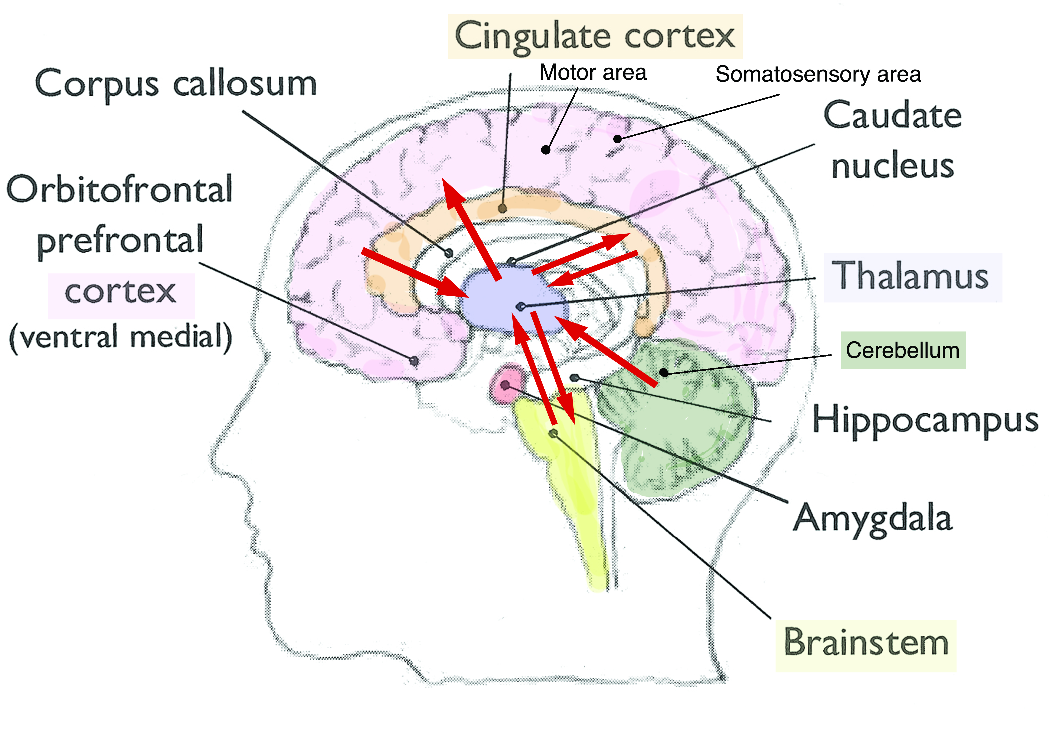
Thalamus: sensation and action gateway between body and brain
Cerebellum-thalamic-cortical circuitry enables reward system / emotional integration as well as aiding movement and cognition
Trauma, (reduced) thalamic connectivity and art therapy - Ref: Walker et al (2018)

Slide 24
Case study 2: session 1 (wk 2)
About to start radio and chemotherapy
Continued limb impairment
Sporadic low mood
Monosyllabic or silent – cognitive impairment?
2 artworks: more coherence
A kind of nervous energy?
Noisy and distracting environment: agree to move to private room next time

Slide 25
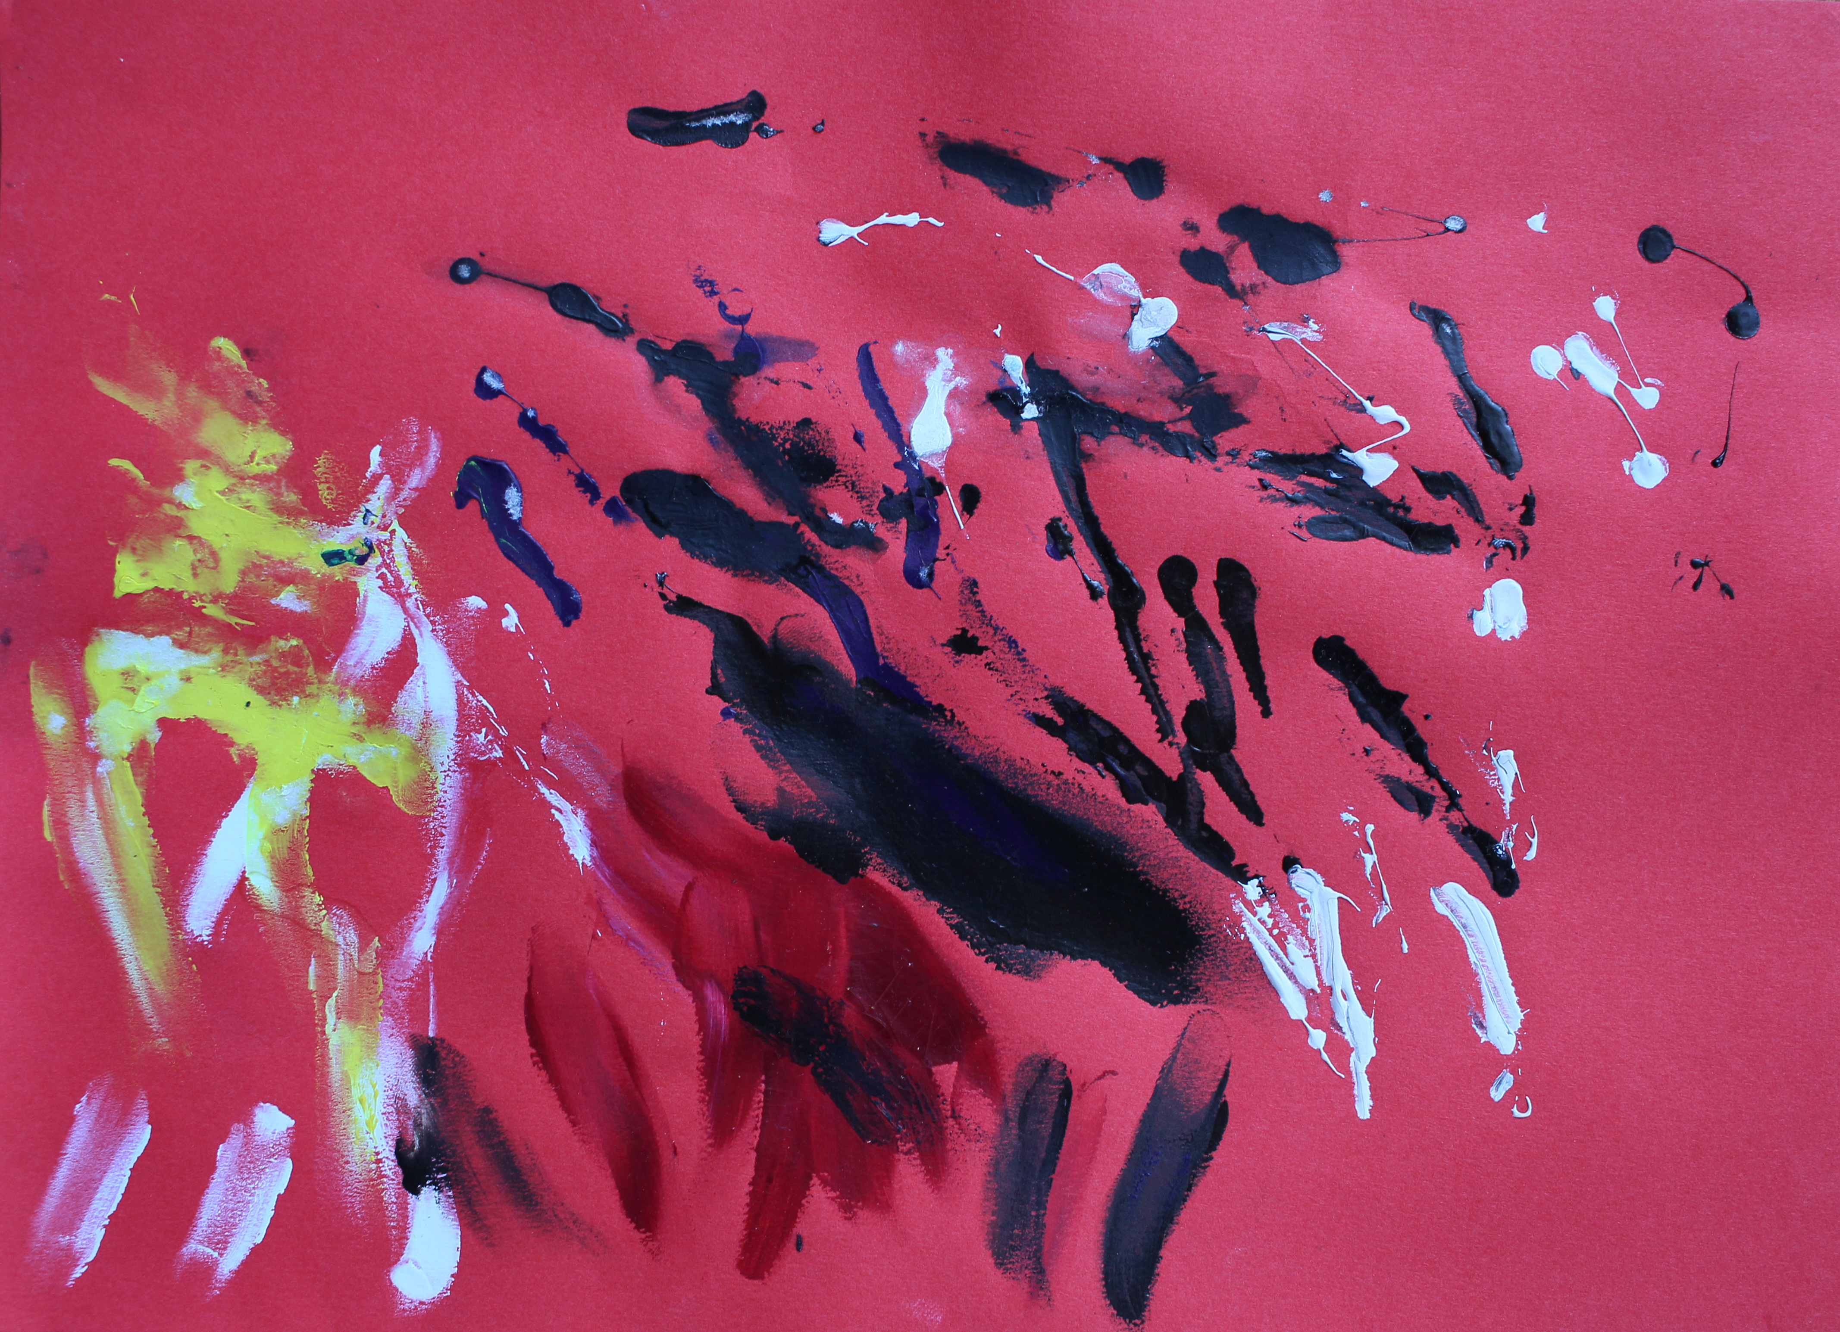

Slide 26
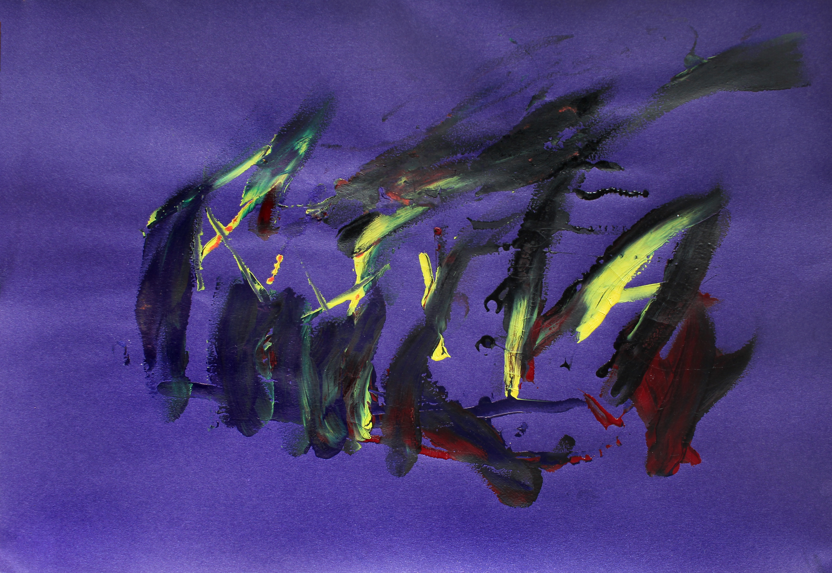

Slide 27
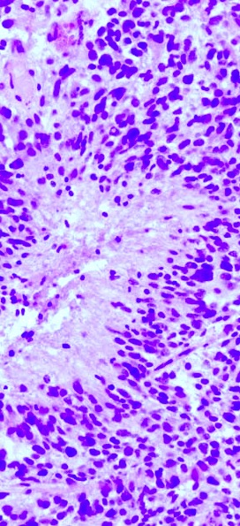
Case study 2: session 2 (wk 3)
How was our relationship? His envy / my guilt
Asking CNS re personality change: patient was previously more engaging, conversational and extrovert
RT had started
Fatigue / weight gain (steroids) ➔ humiliation
More alert, more sad… Frustration; Sadness; Hope
Communication with OT re use of right hand: idea of bilateral engagement
Idea to offer clay

Slide 28
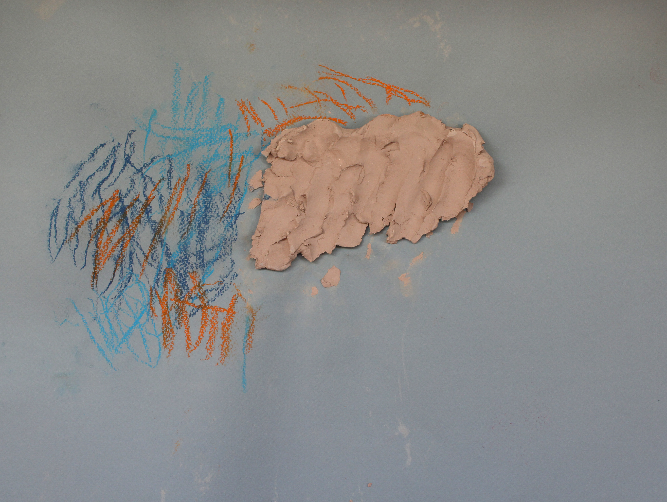

Slide 29
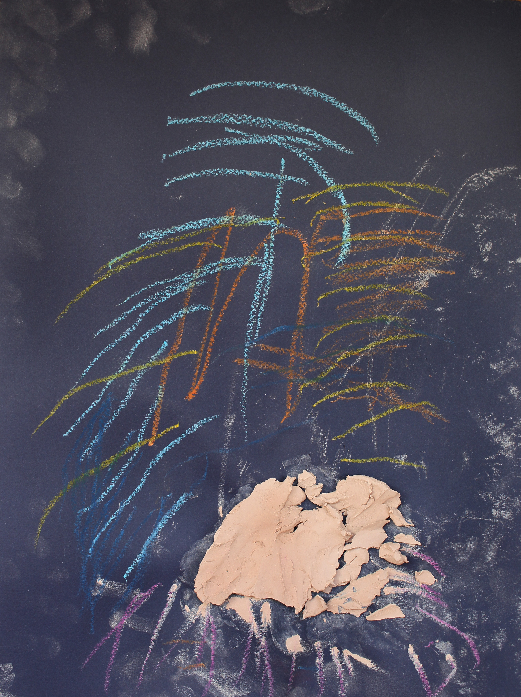

Slide 30
Case study 2: no session(wk 4)
Patient was unable to have session due to clashing appointment
Communicating with partner re possible use of phone/ apps between sessions
Family dynamics and coping mechanisms
Fear of death

Slide 31
Case study 2: declined session (wk 5), final session (wk10)
Wk5 declined session (exhaustion)
Christmas break
Deterioration in impairment and mood
Fatigue, weight gain, hair loss, unable to mobilise
Word-finding difficulties
Clinical psychology assessment and intervention: Patient said about art therapy: “Not sure where it’s going”
Session 4 (wk 10): conversation but no artwork
Patient said he found previous session “demoralising”, spoke of loss of skill / humiliation
Rejection of further therapy
Patient discharged

Slide 32
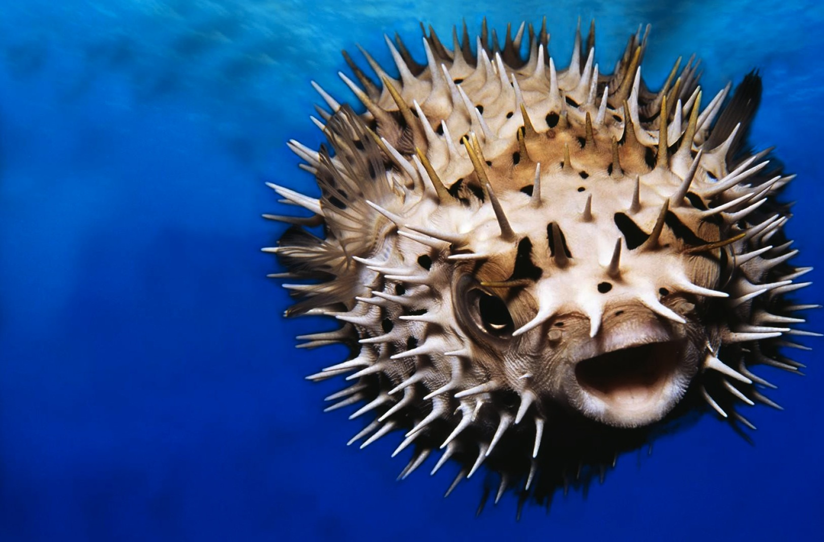
Natural defences

Slide 33
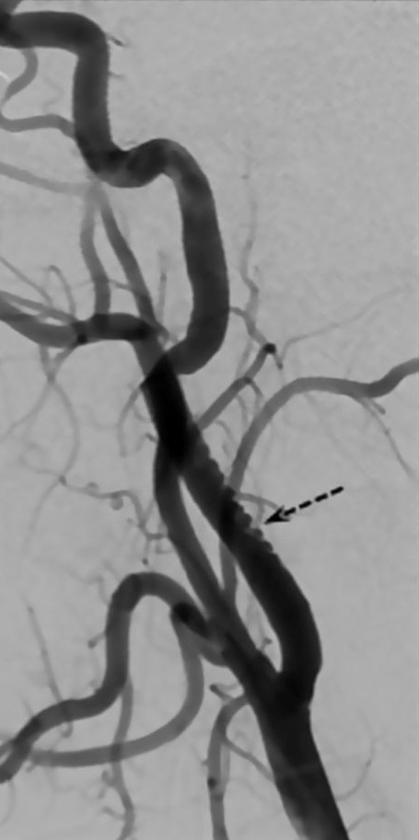
Case study 3
Introduction of art therapy at the setting
Working with a group and an individual
Hospital aims and philosophy
To strive for the highest quality of life for each individual patient at the hospital
Whatever a patient’s level of ability, people should have the right to achieve their full human potential, and best possible quality of life

Slide 34
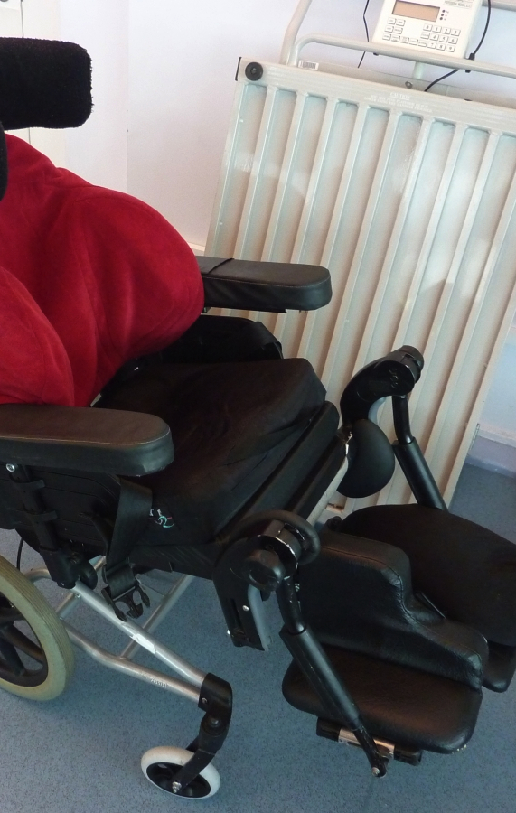
Case study 3
Hospital environment
MDT: occupational therapists, psychologists, music therapists, speech and language therapists, physiotherapists and psychiatrists
8 wards, divided into 4 long stay and 4 rehabilitation
The corridors are decorated with past and present patients’ art work, demonstrating to the outside that the creative process is valued
The art room: established and innovative approaches; directive / non-directive

Slide 35
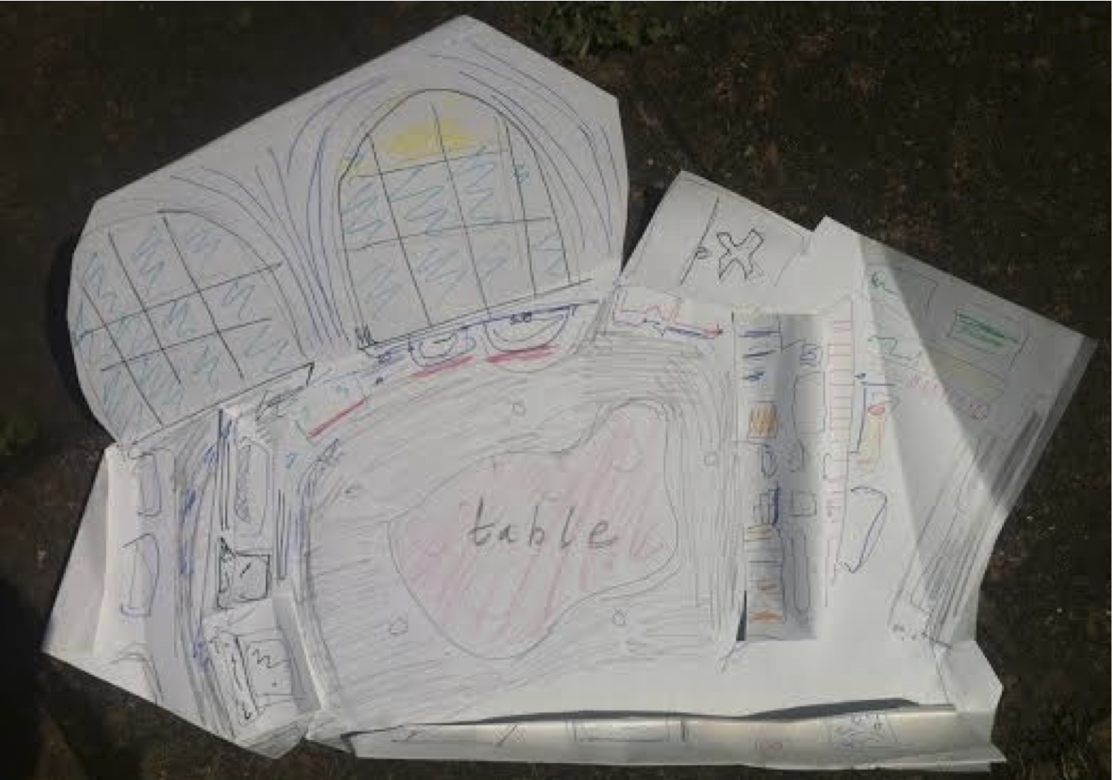
The art room

Slide 36
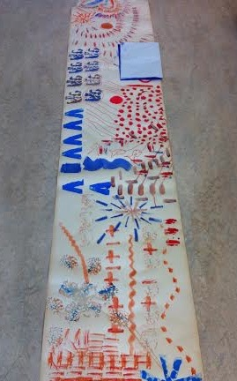

Slide 37
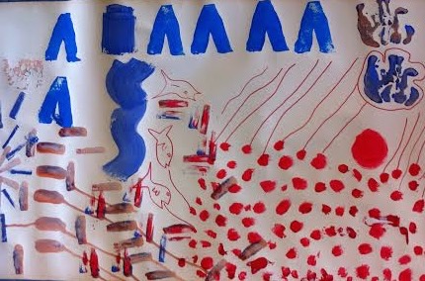
Jungian-informed approach: flexibility in the collective unconscious becomes an important bridge of connection to hope

Slide 38
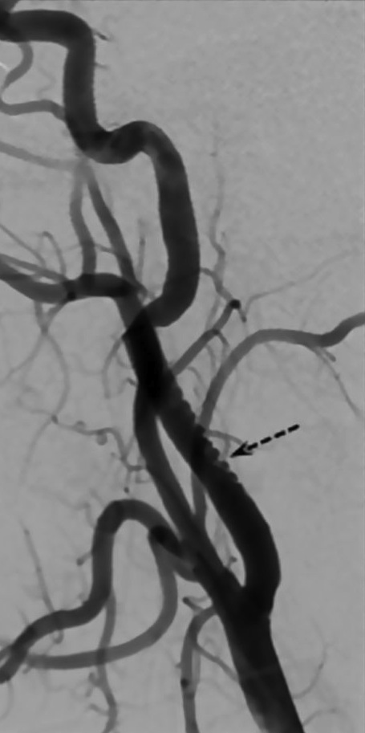
Case study 3: Referral for 1:1 art therapy
Male patient in his 50s
Patient habitually played a dominant male/father role on the ward
Group dynamics and disruptive experiences
Thinking with supervisor and music therapist: useful to give patient space away from the ward, try individual sessions
Initial goals:
Support weak ego / attachment pattern
Work with disinhibition
Reduce discomfort / depression

Slide 39
Case study 3: Personal history
Reported to be from ‘chaotic and unpredictable’ environment
Mother mentally unstable; father left him
Forensic history
Moved to London; living rough
Witnessed armed robbery and was shot in head
Suffered severe damage to front of brain and didn’t start communicating
until 18 months after injury
Referred to RHN
Effects of brain injury
left-side neglect and impaired vision.
Poor initiation and motivation
Sleep disturbance
Aggressive/sexually inappropriate behaviour
Anxiety and depression

Slide 40
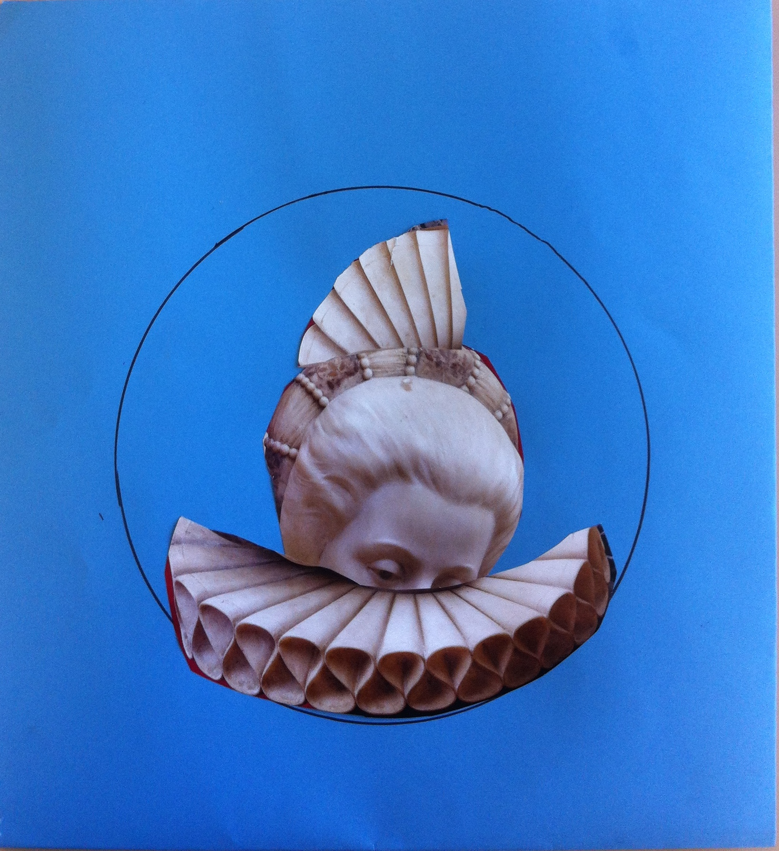

Slide 41
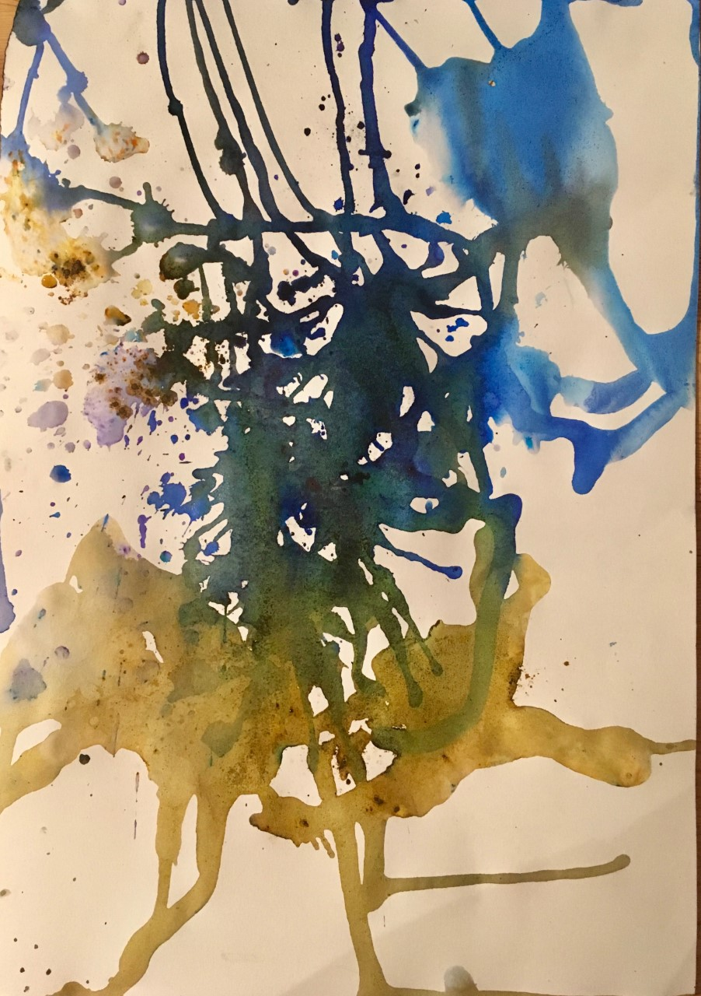

Slide 42
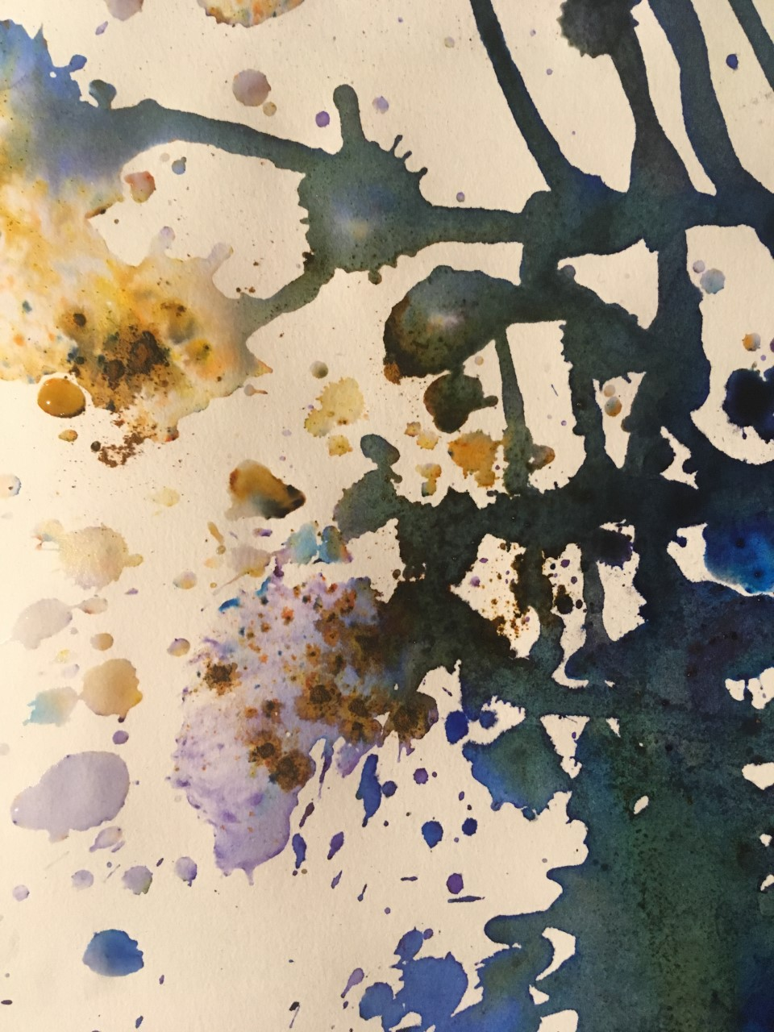

Slide 43
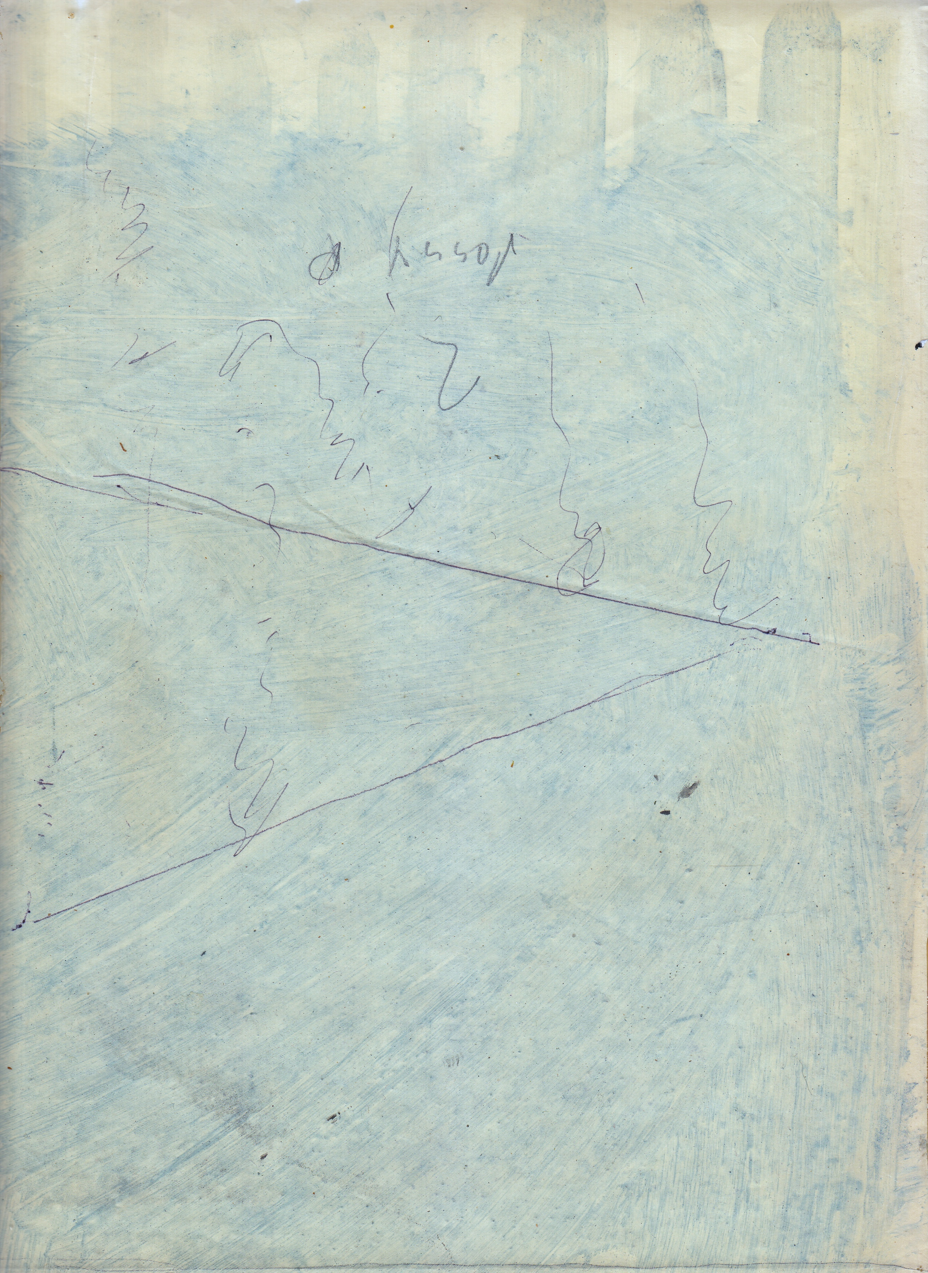
Response art- penultimate session

Slide 44
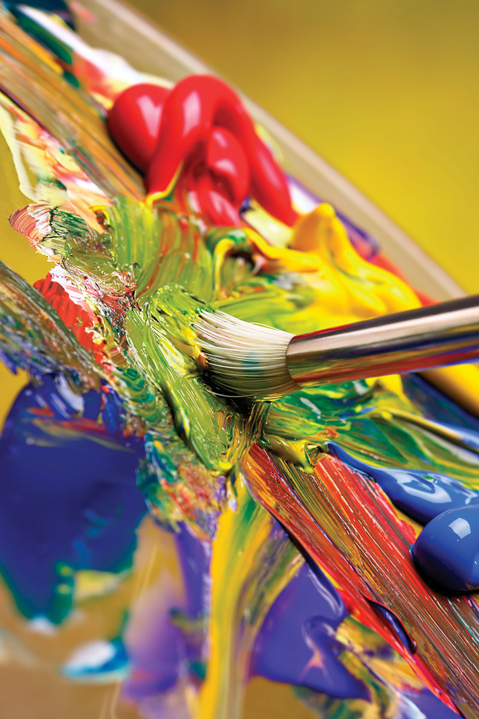
Evaluating the therapy
How might art therapy be uniquely effective with this patient group? (relational; sensory; psychosocial)
Empathic engagement
➔reduced apathy ➔social cognition
Choice and agency
Visual and haptic feedback
Movement and co-ordination
Absorption / distraction / coherence / perseverance
Co-reflecting: acknowledgment & acceptance
See also C-R-E-A-T-E (Hass-Cohen)
Developing evaluative tools
Feedback from patient and others

